Slide 1



PARKLIFY
AUTOMATING YOUR PARKING SPACES
Recharge and Park

Slide 2
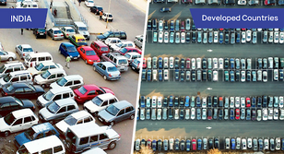
WHAT ARE THE PROBLEMS

Slide 3


UNDERSTANDING THE PROBLEMS
PARKING SPOT ALLOCATION
MANUALLY DRIVEN
More than 300+ Million vehicles in India and parking management is a big issue
Requires at least 12 workers for fee collection and management facility

Slide 4

UNDERSTANDING THE PROBLEMS
SECURITY CONCERNS
LACK OF REAL TIME ANALYTICS
Prone to theft, mismanagement and inconvenience caused to people
Non-transparent charges and No clear information about Slot Availability

Slide 5
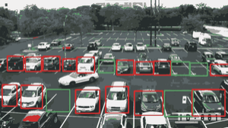





SOLUTIONS WE AIM
Real Time Spot Detection
Our AI Model updates state of all spots in real time with 99.8% accuracy.
Reduce
Search Time
No need to search spot yourself, we will allocate nearest one to you.

Slide 6






SOLUTIONS WE AIM
SECURE AND BACKED BY PROVEN TECHNOLOGIES
Cutting edge Technologies to facilitate Security and Safety of people
24*7 surveillance to ensure safety of vehicles parked in the lot.

Slide 7

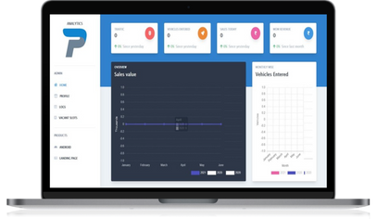

SOLUTIONS WE PROPOSE
RELIABLE RECORDS AND ANALYTICS
Provide complete analytics to the parking lot owners including their
Revenues
Monthly Sales Graph
Real Time Availability of Slots
analytics.parklify.com

Slide 8

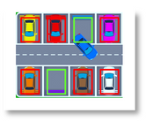



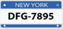





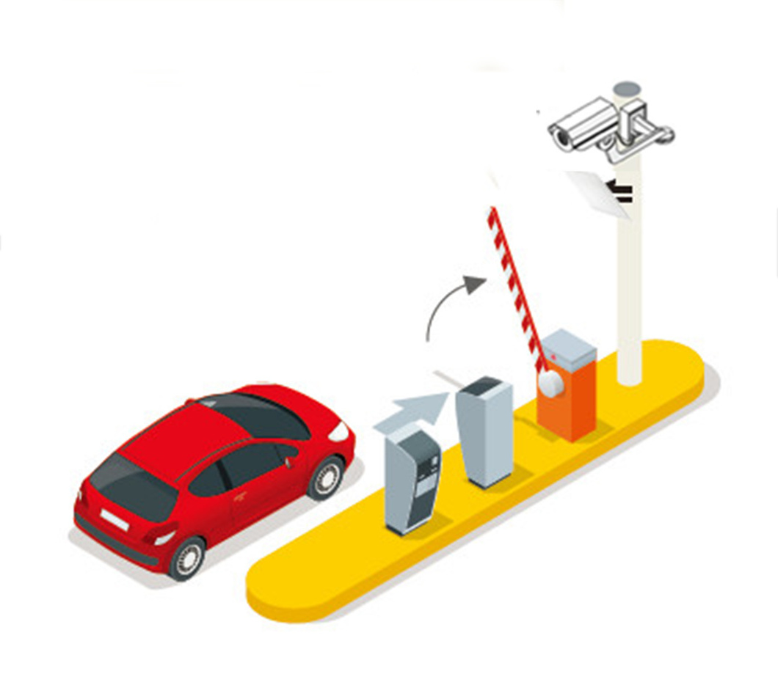

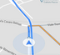


WALK-THROUGH
Real Time Spot Detection
Car Entering
RFID Scanned
Slot Allocated
SLOT 16
Automatic Payment
Car Exiting
Slot Navigation
Entry Permitted
SLOT 16
PAID ₹30

Slide 9


CURRENT PROGRESS AND IMPLEMENTATION
HARDWARE INNOVATIONS ON BOOM BARRIER (IoT)

Slide 10






OUR TEAM
AKSHAT TIWARI
Lead Android & iOS Developer (DTU)
YASH SAINI
Lead Hardware & Firmware Engineer (DTU)
PRASHANT RANA
Lead Backend Developer
(DTU)
TUSHAR CHOPRA
Lead Web Developer
(DTU)

Slide 11


THANK YOU

